Slide 1
Ports & Registers

Slide 2
PORTs and Registers
Groups of 8 pins are called PORTs.
  Each bank is alphabetical. There is PORTA, PORTB, PORTC…
We access them via memory mapped registers
  8 pins means 8 bits to represent. [most] Registers are 8-bit.
  Our microcontroller is 8-bit…coincidence?
Memory-mapped I/O makes programming magic
  1605 = 4; // Sets pin 3 on PORTC to output?!?!?

Slide 3
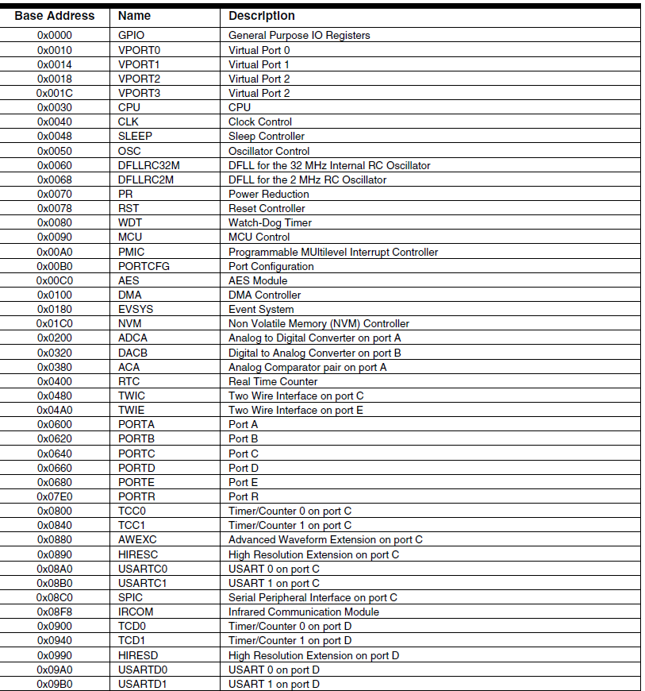
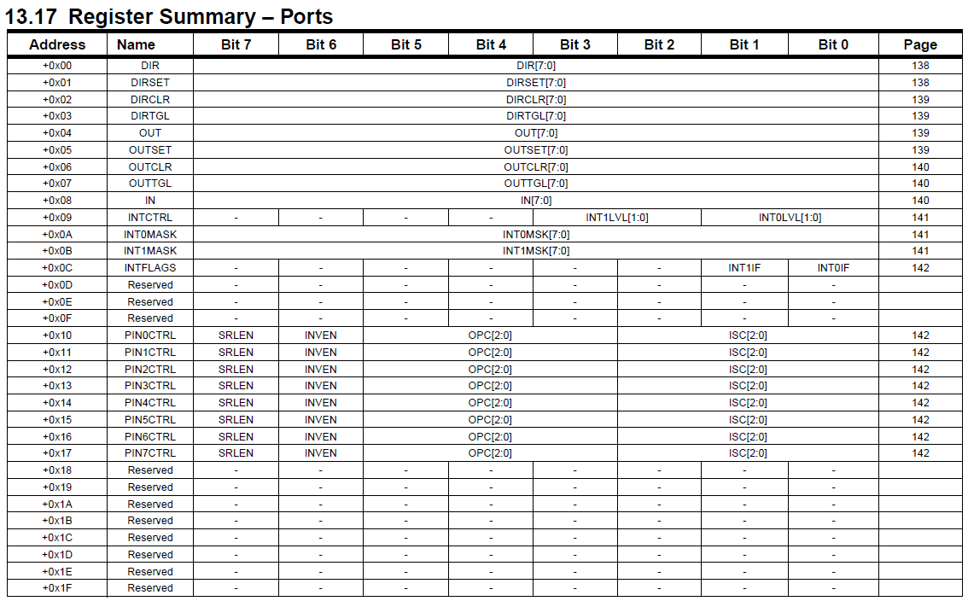
Memory Mapping

Slide 4
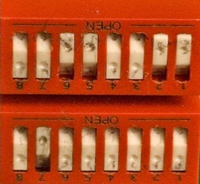

What’s really going on
Configuration registers are banks and banks of switches
ON/OFF is 1/0
Programming is much easier than using tiny tweezers
PORTA PORTB PORTC PORTD

Slide 5
Input/Output Ports
A basic capability of any microcontroller (p54)
A PORT is a collection of pins, usually 8
Some basic but very handy configurations (p55)
  Digital Input:
    0 → 0V on pin
    1 → Vcc on pin (~3.3V in our case)
  Digital Output:
    0 → 0V, sink 20mA
    1→ Vcc, source 20mA

Slide 6
Configuring a port, general
Basic DIO is controlled by a few registers
  DDRx → Data Direction Register
  PORTx → Output Register
  PINx → Input Register

Slide 7
Setting I/O
Code | Description
DDRB = 0xFF | All pins are now outputs
DDRB |= _BV(PB1) | Set pin1 to output w/o upsetting others
DDRB &= ~_BV(PB1) | Set pin1 to input w/o upsetting others
PORTB |= _BV(PB5) | Set only pin5 to output high
PORTB &= ~_BV(PB5) | Set only pin5 to output low
PORTB = (PORTB & ~_BV(PB5)) | (someVal << PB5) | Set pin high/low based on some val
This page will save you a lot of time on the homework
Register worksheet if you need additional help/work.

Slide 8
Some comments
Use of functions and #defines
  Register manipulation is ugly. Keep it all in one place.
  Please use them for readability.
  They also massively increase portability
  For the most part performance won’t be an issue for us
Using support .c and .h files is good practice
  Lets you have many applications with the same core functions
  In Homework, you’ll be modifying mg2.c, not the main file
  It’s actually a lot lazier in the long run

Slide 9
Configuring a port, output
Ex 1: Pin as output
#define LED PB1 // LED on pin 1 of PORTB
void initLED(void)
{
DDRB |= _BV(LED); \\ sets data direction to out
PORTB &= ~_BV(LED); \\ defaults to low voltage, which may mean OFF
}
void setLED(int val)
{
if(val)
{
PORTB |= _BV(LED); \\ set high, ON
}
else
{
PORTB &= ~_BV(LED); \\ set low, OFF
}
}
What happens if we call setLED before we call initLED?

Slide 10
Configuring a port, input
Ex 2: Pin as output
#define BUTTON PB3 // pin3 on PORTB
void initSense(void)
{
DDRB &= ~_BV(BUTTON); \\ sets data direction to in
}
int getSense(void)
{
return (PINB & BUTTON); \\ returns non-zero if SENSE1 reads high
\\ returns 0 if SENSE1 reads low
}

Slide 11
Delays
Might be useful to add a delay to your loop.
You can _delay_us(int delayTime) and _delay_ms(int delayTime)
How they work:
  _delay_ms(X) waits for X milliseconds
  _delay_us(X) waits for X microseconds

Slide 12

Time for a Segue

Slide 13
What’s due, When?
Scavenger Hunt Homework, Due this Wednesday
Programming - register configuration to blink an LED and read in the button, Due next Monday
  Need to install software, see course documents on “AVR Toolchain Installation” and “Compile and Download”
Gadget 1 use case, Due next Wednesday (2/6)
Homework 5 on Eagle, will be assigned Wednesday, due next Wednesday (2/6)
Office hours! Thursdays and Sundays 6:30-7:30
  Please use them, especially if you need extra help with programming

Slide 14
Schematics
&
Intro to PCB CAD

Slide 15
What this Week Covers
Basic Schematics
  What a schematic represents
  Key features
    Components
    Nets
    Rails
Printed Circuit Boards
  What they’re about
  How do we make them
  Historical PCBs from old to modern
Eagle – Computer Aided PCB design
  Schematic Capture, What it’s all about
  Layout, Physical Representation
  ERC/DRC
Brief Eagle Tutorial (schematic tools / layout)
  Install EAGLE if you haven’t

Slide 16
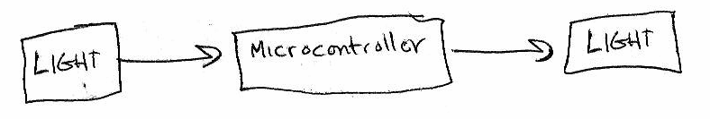
A picture is worth a thousand words
Schematics represent circuits graphically
Consider one use of the Minigadget:
A little vague, but still a schematic
A good schematic shows what and how

Slide 17
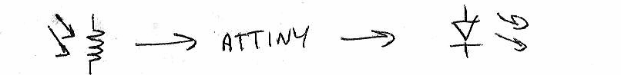
Adding detail with symbols
Using specific symbols tells more information
A photocell is read by an ATTiny microcontroller which lights an LED
Shows you’ve thought about what you’re using
But ??? is not a good Step 2

Slide 18
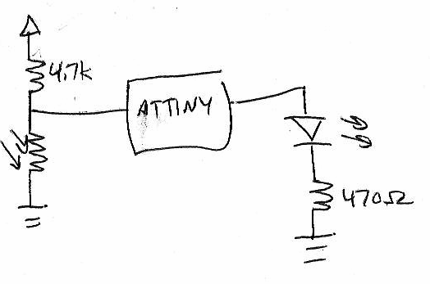
Adding detail with basic circuits
Explaining how requires circuit diagrams.
A photocell in a voltage
divider is read by an
ATTINY which outputs
to an LED with a
current-limiting
resistor

Slide 19
Circuits in Gadgetry
We can’t cover electronics in general
We will cover basic interactive gadget circuits
  How to hook up sensors and read digital or analog values
  How to hook up actuators and set digital or analog values
We have a low tech worksheet on basic circuits.
  Why batteries have a + and - end
  How voltage and current relate
  EE Fundamentals under Course Documents
For now, we will focus on schematic capture and representation.

Slide 20


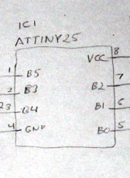





Minigadget cast of characters
Basic Parts:
Resistor
limits current
“ties” voltage
(pullup/pulldown)
Capacitor
steadies voltage
“tiny UPS”
Integrated Circuit
Uses vary widely
Each labeled number
represents a leg/pin
LED
Light
Emitting
Diode
Battery
Provides power
More abstract symbols:
Vcc – Power Rail
Represents logic “1” voltage
NETS
Lines or
“wires”
represent
connections
GND – Power Rail
Represents logic “0” voltage
Many, many more symbols out there. Ex: http://www.kpsec.freeuk.com/symbol.htm

Slide 21
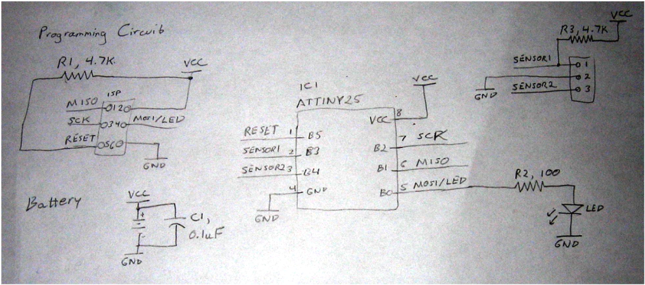
Spring 2010 Minigadget Schematic
Lots going on! A complete schematic.
However, still missing a few details we’ll discuss later

Slide 22
Eagle CAD
Two tools in one:
  schematic capture
  printed circuit board layout.
Need to have a schematic to create a PCB!
Pros
  Freeware for non-commercial use
  Very popular with the Sparkfun / Hobby crowd
  Written by PCB engineers, generally just works
Cons
  Size limit with freeware version
  Missing some handy features for complex boards
  Written by PCB engineers, bizarre interface

Slide 23
Eagle Tutorial!
No one deserves to figure out Eagle on their own
  We’ll be covering some basic operations
  Dealing with some charming interface features
Fire up eagle
  Laptop
Additional reference material online in Course Documents->Eagle Commands

